Slide 1
Costume Parade at Honeygo Elementary
Thursday, October 31, 2019
9:15 Regular arrival at school. Students should come to school their regular way. Students should wear their costume to school, but bring a change of clothes for after the parade.
9:45 Our Costume Parade will begin. Please see the attached map for parade route.
Parking- You may park in the front parking lot, the rear lot or the bus lot if it is after 9:30am. Please be sure not to block anyone in. Please do not come into the bus lot before 9:30am. Additional parking may be available across the street at Soukup Arena. Thank you for helping, as parking is limited when we host full school events. All cars must be off the bus loop by 11:30am.
After each Preschool – Grade 2 class parades around the building one time, they will head back into their classroom and students in Grades 3-5 will parade. We kindly ask you only come into the school if you have made arrangements with your child’s teacher to assist with classroom activities. Classroom teachers will communicate with parents their plans for the remainder of the school morning. Any parents invited by teachers to come in, will have to sign in at the main office with their identification. All volunteers must be BCPS volunteer trained and on our approved volunteer list prior to this date.
Other Helpful Information:
In the event of rain, the parade will be cancelled.
Excessive make-up is best to be used during your family’s or neighborhood’s Halloween celebration.
Students may not bring look-a-like weapons of any kind. Example: guns, knives, claw like fingernails.
Costumes do not need to be violent to be fun. If your child is a clown, make sure it is a friendly clown. Violent looking clowns are not welcomed at school.
Teachers will determine the appropriateness of any questionable props.

Slide 2
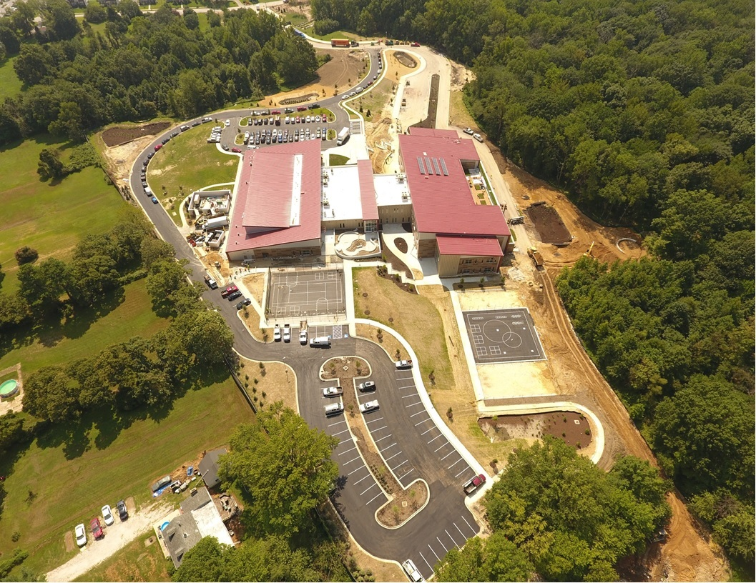
For Parents ~ In order to ensure a safe and festive Costume Parade, please adhere to the following guidelines:
Arrive at 9:30. Consider parking at Soukup Arena and walking over.
You may sit or stand anywhere along the outside perimeter of the school.
Please stay off of the side walk, in order to allow classes to walk by with plenty of room.
Classes will exit the front of the building, and walk around the school once.
Classes will enter and exit out the front doors.
Parade route details:
Start and end at front of school
For those families whose children may not participate in our Costume parade, the school will host appropriate Fall Activities in the library. Please send a note to your child’s teacher stating this request.

